Slide 1
Mini Project 2
Prescriptive Analytics -Delivering Understanding
Leveraging CRISP-DM for Effective Data Mining — Group 3 —

Slide 2
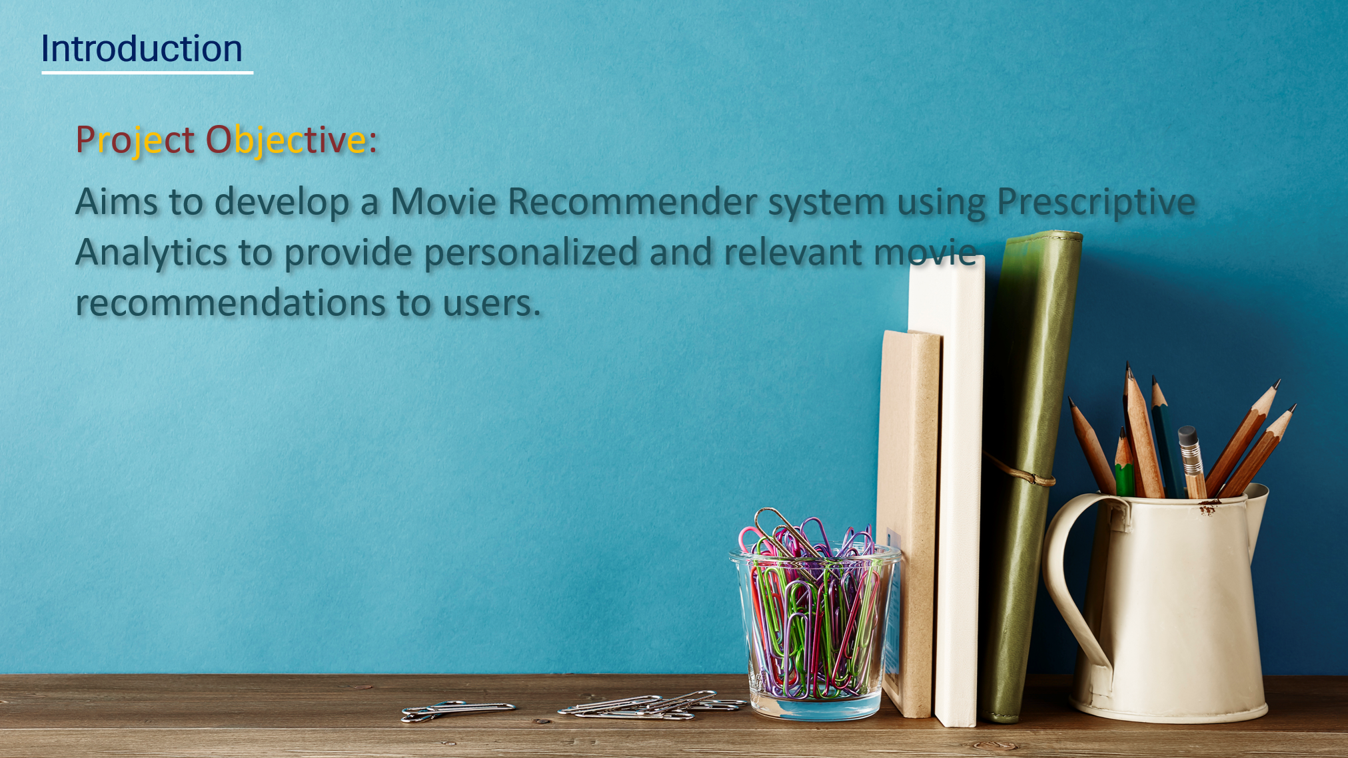
Notes:
Script: Today, I am excited to present our project aimed at developing a Movie Recommender System using Prescriptive Analytics. Our goal is to leverage advanced data science techniques to provide personalized movie recommendations to users, enhancing their viewing experience.

Slide 3
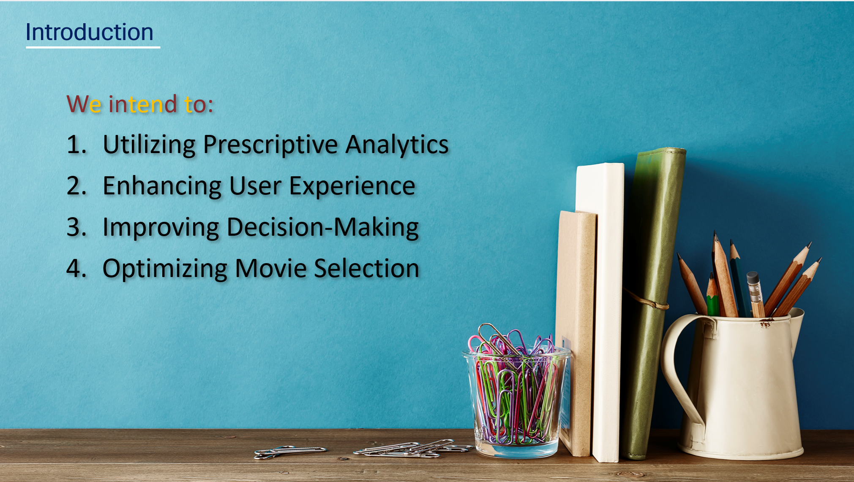
Notes:
Script:
Project Aims:
1. Utilizing Prescriptive Analytics: Apply Prescriptive Analytics to effectively address the challenge of recommending movies to users based on their preferences and viewing history. By analyzing user behavior and movie features, we seek to provide tailored recommendations that align with individual tastes.
2. Enhancing User Experience: Enhance the user experience by offering accurate and relevant movie suggestions through the use of advanced algorithms and data analysis, this resulted in delivering personalized recommendations that cater to the diverse preferences of our users.
3. Improving Decision-Making: Our system will not only recommend movies but also provide insights into why a particular movie is being suggested, enhancing transparency and user trust.
4. Optimizing Movie Selection: To optimize the movie selection process for users, ensuring that they discover new and engaging content that aligns with their interests.
We seek to streamline the recommendation process and deliver valuable insights to users.

Slide 4
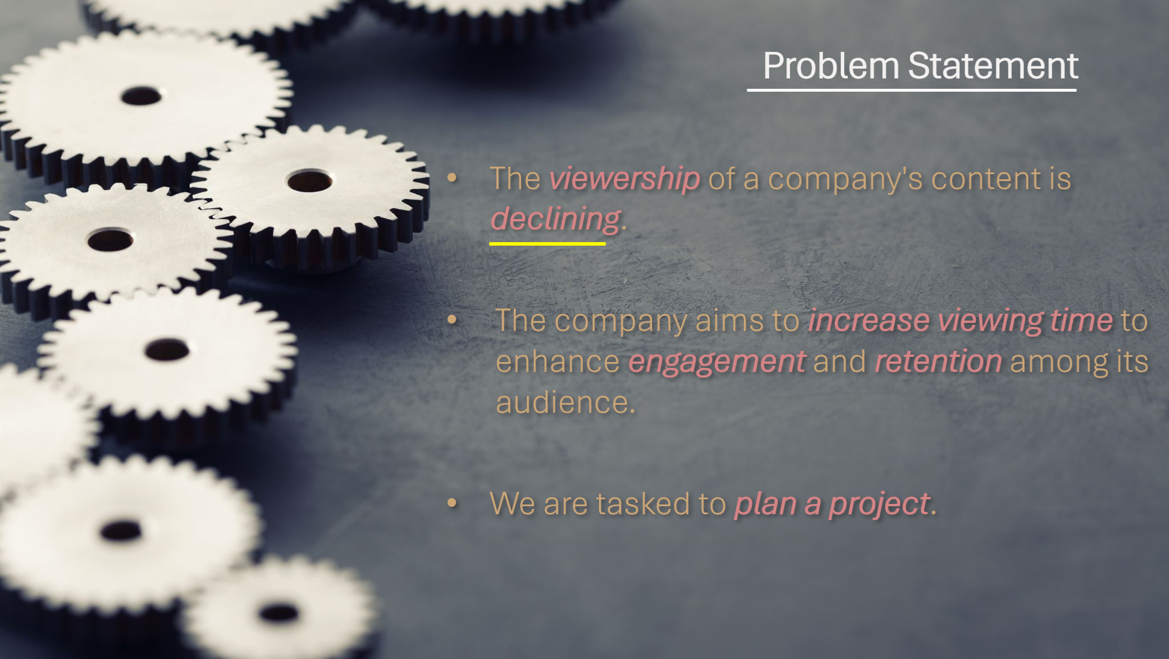
Notes:
Script: The company is facing a decline in viewership of its content, leading to a need for strategic intervention to revitalize audience engagement and retention. To address this challenge, the company has set a goal to increase viewing time and enhance overall audience engagement. In response to this imperative, our project is tasked with developing a Movie Recommender system using Prescriptive Analytics.

Slide 5
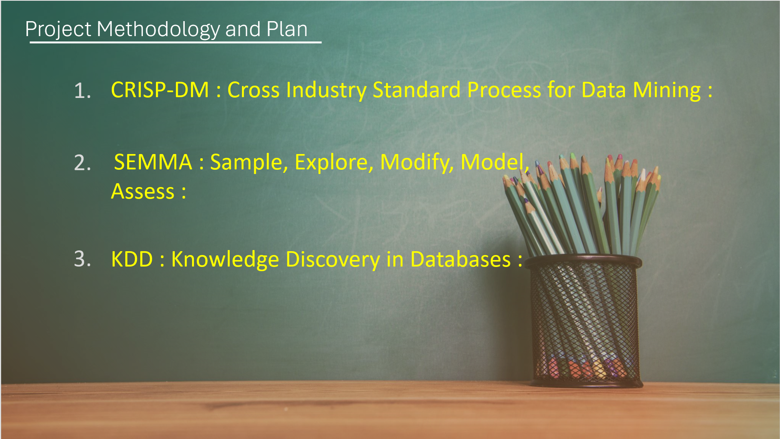

Slide 6
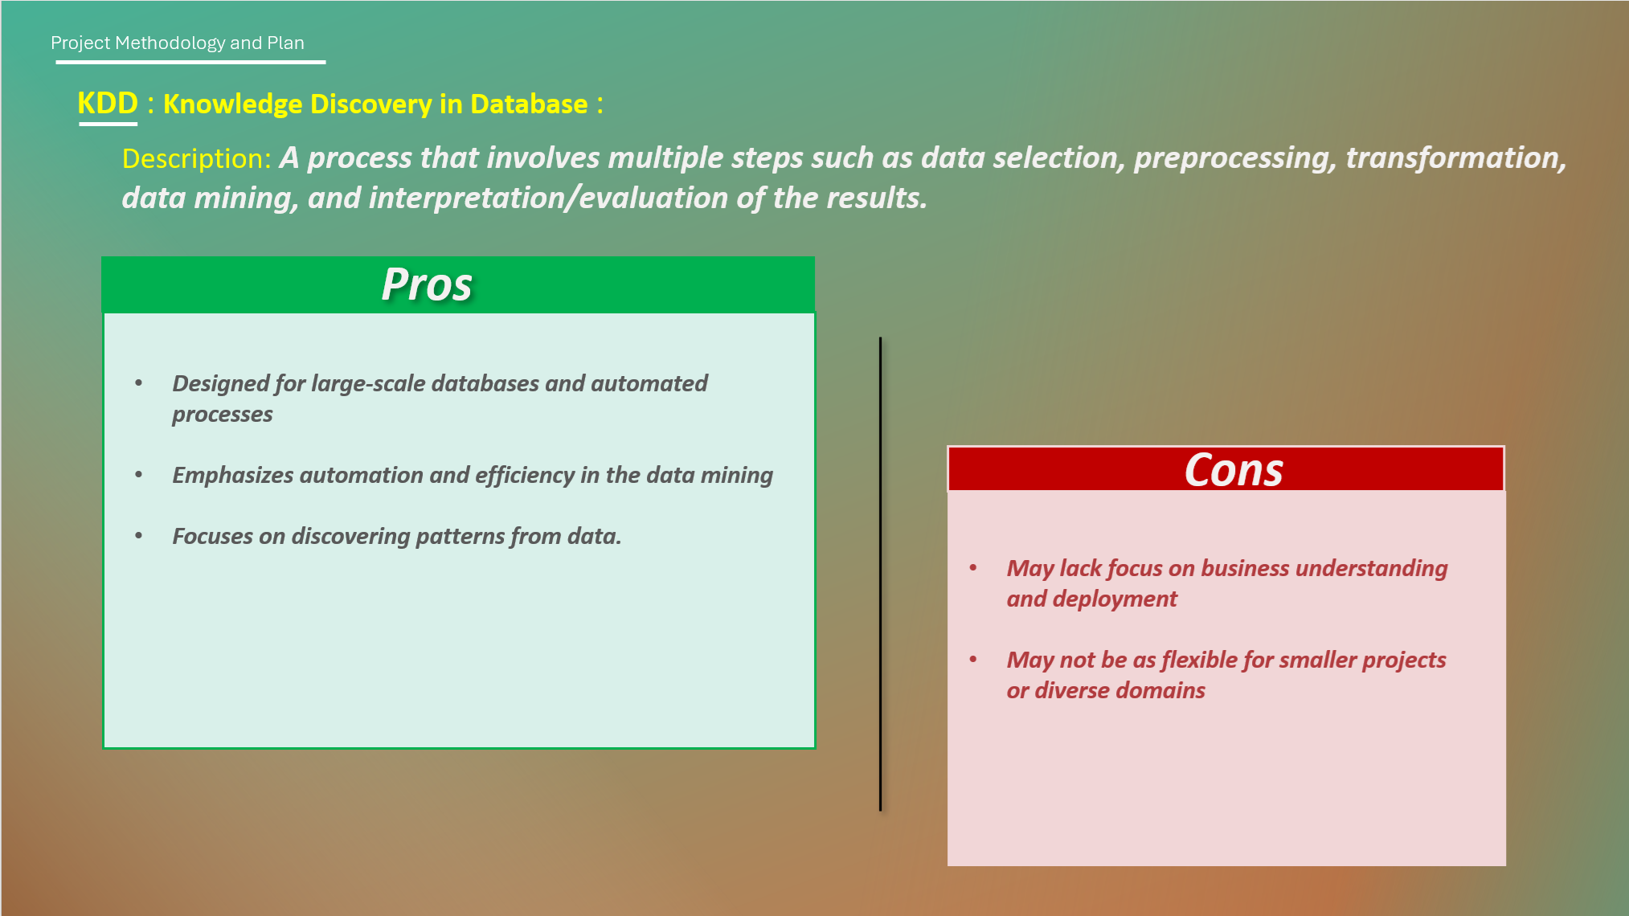

Slide 7
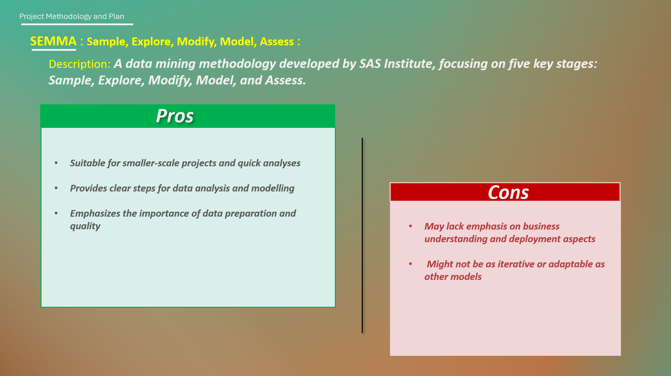

Slide 8
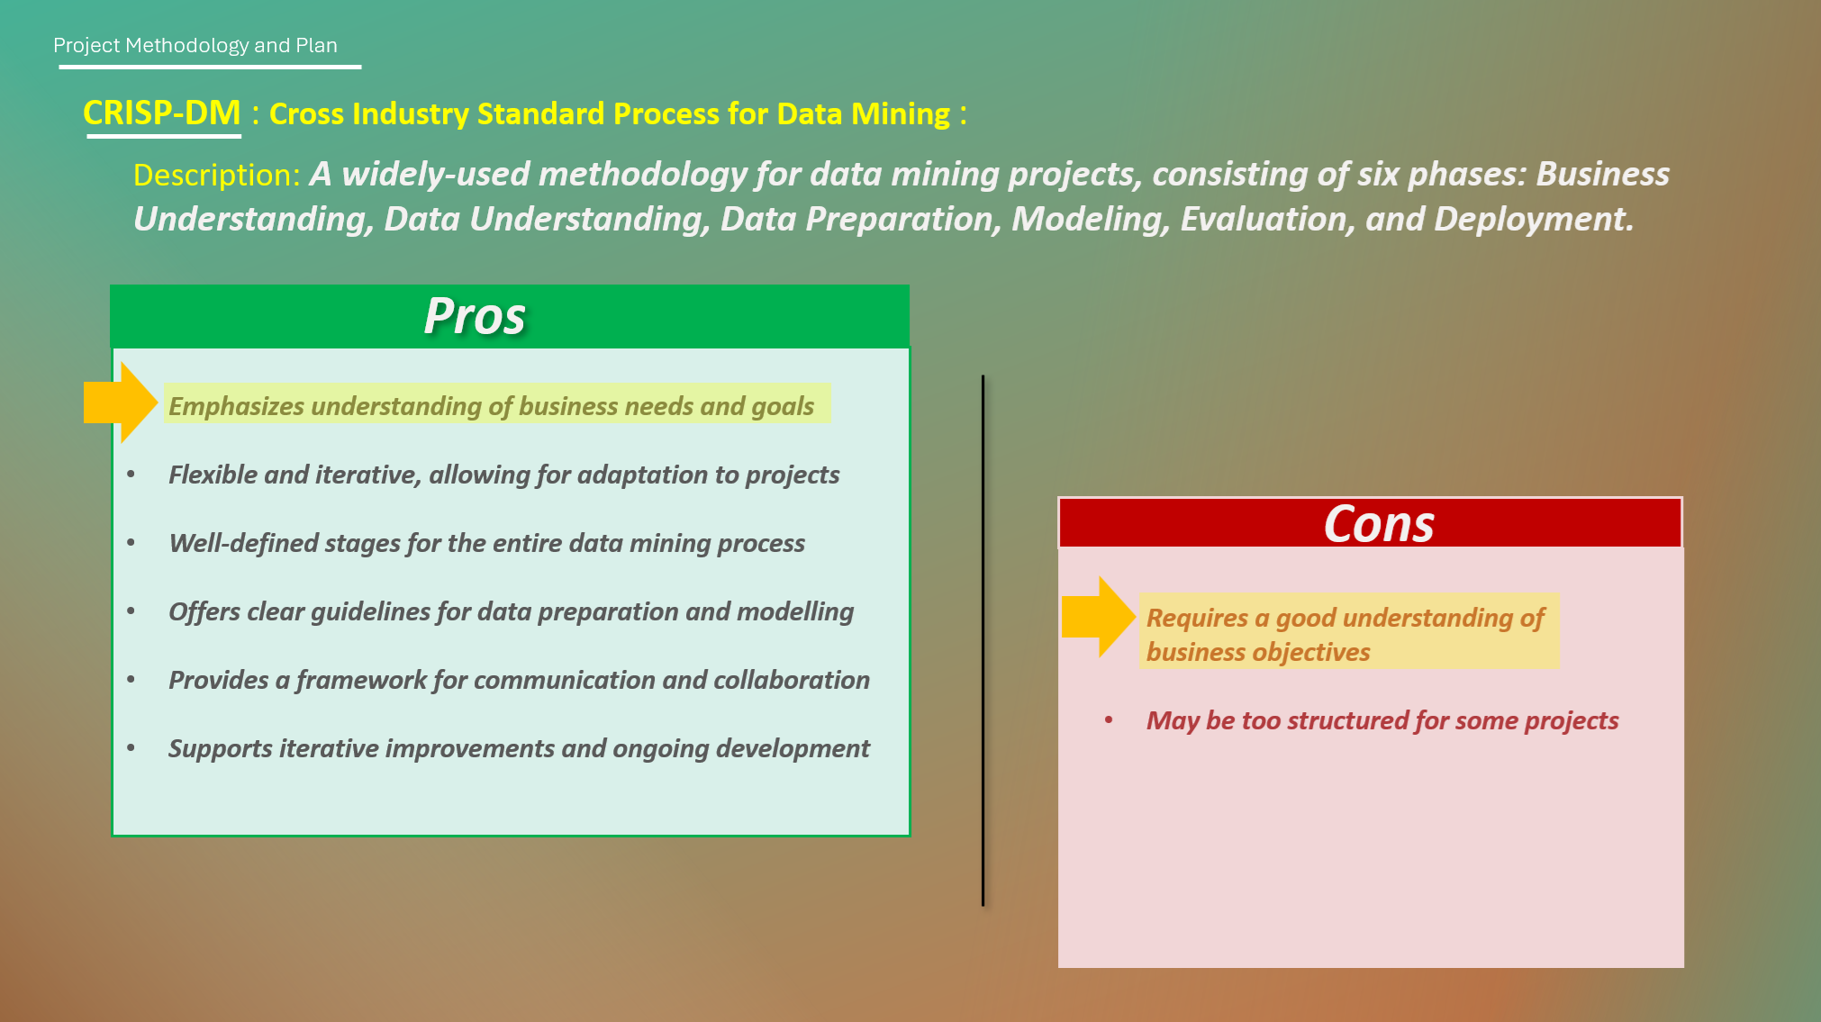

Slide 9
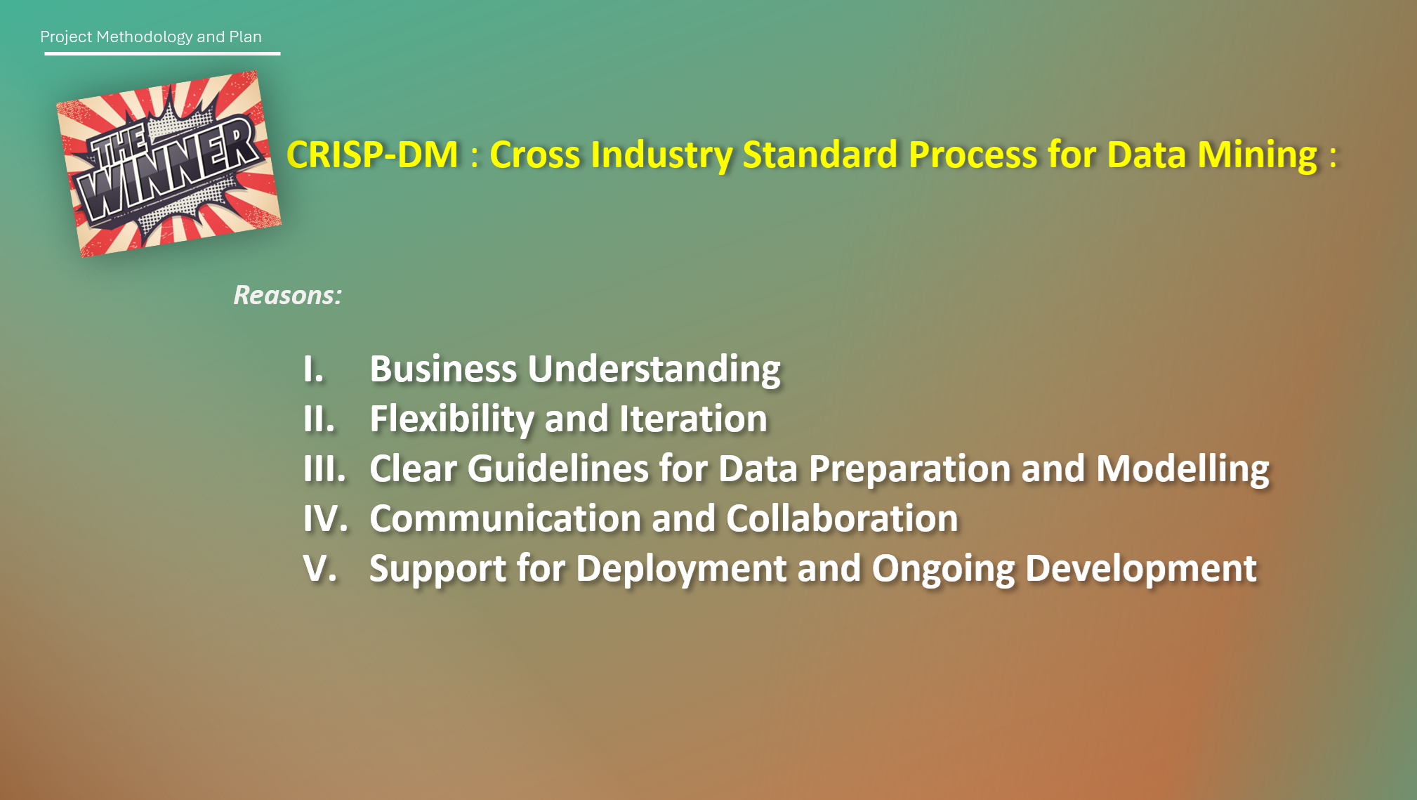

Slide 10


Slide 11
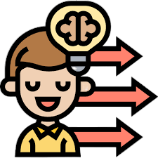
Business Understanding
Notes:
Determine Business Objectives
Understand Customer Needs: The primary business objective is to enhance user engagement and satisfaction by providing personalized movie recommendations. This could involve understanding user preferences, viewing habits, and feedback to recommend movies that they are likely to enjoy.
Business Success Criteria: Success can be measured by an increase in user engagement metrics such as time spent on the platform, click-through rates on recommended movies, conversion rates (e.g., from browsing to watching), and improved user retention.
2. Assess Situation
Resources Availability: Assess the data available for training the recommendation system. This includes user data (preferences, watch history), movie metadata (genre, director, cast), and user feedback (ratings, reviews).
Project Requirements: Determine the technical requirements, including data storage, processing capabilities, and algorithms for recommendation (e.g., collaborative filtering, content-based filtering, machine learning models).
Risks and Contingencies: Identify potential risks such as data privacy issues, data quality, and biases in recommendations. Develop contingencies such as implementing robust data governance and bias mitigation strategies.
Cost-Benefit Analysis: Evaluate the costs involved in developing and maintaining the system against the expected benefits in terms of increased user engagement and subscription revenue.
3. Determine Data Mining Goals
Technical Objectives: From a data mining perspective, the goal is to develop an algorithm that accurately predicts user preferences and suggests movies that match these preferences.
Success Metrics: Technical success can be measured by metrics such as precision, recall, and the F1 score of the recommendation system. Additionally, A/B testing can be conducted to compare the effectiveness of different algorithms or models.

Slide 12

Identifying Key Stakeholder
Management:
Responsible for setting strategic goals and objectives for the company
Provide resources and support the initiative
Make the final decision
Marketing and Sales Teams:
Acquiring new subscribers via targeted campaigns
Tasked with retaining existing subscribers
Provide feedback on the effectiveness of marketing initiatives
Go-to-Market strategy: Insights into consumer’s behavior, market trends, and competitor strategies
Notes:
These are the stakeholders involved in our project

Slide 13


Identifying Key Stakeholder
Customer Support:
Act as the primary support contact for user inquiries, feedback & complaints
Provide technical assistance to resolve both new and recurring issues
Provide feedback and collaborate with internal teams to address user concerns
Partners & Vendors:
Collaborate with Content Creator agencies to acquire exclusive contents and streaming rights
Partner with Studios Production companies to gain access to latest movies
Harness Partnership within the market to identify user trends & preferences

Slide 14
Identify Factors
Non-competitive subscription pricing
Poor content discovery
Algorithms performing poorly
Inadequately designed Interface
Poor Testing & Iteration plan
Notes:
Here are some concerning factors that may affect viewership, this is our external factors

Slide 15

Key Deliverables
Analysis of Reporting
Better Recommendation algorithms
Re-designed UI/UX prototype
Implementation plan with phased rollouts of changes
Performance Monitoring framework
Notes:
A comprehensive report analyzing factors contributing to the decline.
Recommendations for improvement based on data-driven insights & market research
Revised pricing strategies reflecting insights from research, competitive analysis & customer feedback
Recommendation for adjusting pricing tiers, promotions & bundle options to attract/retain subscribers while being competitive
Enhancement to platform’s discovery features such as search functionality, personalized recommendation and content curation capabilities
Optimization of recommendation algorithms using ML & AI techniques to deliver accurate & relevant content suggestions
Prototyping & Wireframe illustrating the redesigned UI/UX to improve user experience
Iterative design concept to address usability, navigation and visual appeal
Detailed implementation plan outlining phased rollouts
Testing approaches including A/B testing, usability testing and pilot programs to validate effectiveness and gather user feedback
Development of performance monitoring to track key metrics and KPIs
Design & implement KPI Dashboard providing real-time insights into the progress of initiatives & impact of the implemented changes.

Slide 16

Project Success Criteria
Increase in subscription numbers by X%
Improvement in average viewing time per user by X minutes.
Positive Feedbacks from users regarding UI/UX
With this in mind, we can create a system to tackle the problem.
Notes:
With the key deliverables in place, we will need a success criteria to monitor the performance. Here are the 3 main focuses.
We can now create a prototype system to tackle the problem. Firstly, we need our Data.

Slide 17

Data Understanding
Notes:
For a movie recommendation system, the Data Understanding phase involves detailed interaction with the data that will be used to train and test the recommendation algorithms. This phase is critical for ensuring that the data is appropriate and of high quality, which is fundamental for achieving accurate and useful recommendations. Let's break down the tasks involved in this phase:
1. Collect Initial Data
Data Acquisition: The first step is to gather data relevant to the recommendation system. This could include:
User Data: Information on users' profiles, including demographic data (age, gender, location), preferences, and historical interactions with the platform (ratings, reviews, watch history).
Movie Data: Detailed metadata about movies, such as titles, genres, release dates, directors, cast members, and descriptions.
Ratings and Reviews: User-generated ratings and reviews for movies, which can provide insights into preferences and movie popularity.
Loading Data: Once collected, the data needs to be loaded into an analysis tool or environment, such as a database, data lake, or a data analysis software, ensuring it's ready for exploration and modeling.
2. Describe Data
Data Format: Determine the format of the collected data (e.g., CSV, JSON, SQL database) and ensure compatibility with analysis tools.
Number of Records: Count the total number of records in each dataset to understand the scale you're working with.
Field Identities: Identify and document the fields available in your datasets, such as user ID, movie ID, genres, ratings, and timestamps of interactions. This helps in understanding what information is available for building the recommendation logic.
3. Explore Data
Query Data: Perform initial queries to get a sense of the data distribution, such as the number of users, movies, average ratings, and the distribution of movie genres.
Visualize Data: Use visualizations to identify patterns, outliers, and relationships within the data. For example, histograms of ratings can show distribution preferences, while scatter plots can reveal relationships between movie characteristics and ratings.
Identify Relationships: Look for correlations between different data points, such as user demographics and movie preferences, or the relationship between the time of day and movie selection. These insights can inform the recommendation strategy.
4. Verify Data Quality
Cleanliness: Assess the cleanliness of the data by checking for missing values, duplicate records, inconsistent data formats, and outliers. Document these issues as they will need to be addressed in the Data Preparation phase.
Quality Issues: Identify any signs of biased or skewed data, such as overrepresentation of certain movie genres or user demographics. This could affect the fairness and effectiveness of the recommendation system.
This phase lays the groundwork for building a robust movie recommendation system by ensuring a thorough understanding and documentation of the available data. The insights gained from this process not only inform the subsequent phases of the project but also highlight potential challenges and opportunities for enhancing the recommendation engine.

Slide 18






Where are our data from
Company existing database
Open-source or external sources
Movie Metadata
Gather Customers’ feedback & Surveys
Collaborations with industry partners or data-sharing agreements with relevant platforms to access their data

Slide 19
What are our Data?
Gather data from various sources, including:
User profiles and demographic information.
Viewing history and preferences.
Engagement metrics and user interactions.
Customer feedback and support tickets.
Competitor analysis and market trends.
Notes:
In order to meet our project criteria, we need to identify what data is relevant. Here are some possible data points we can use.

Slide 20

Data Preparation
Notes:
III. Data Preparation
3. Construct Data
Deriving Attributes: Create new features that could enhance the model's performance. For example, from the timestamp of ratings, derive features like "time since last activity" to capture user engagement or "time of day" to understand viewing preferences.
4. Integrate Data
Combining Data Sources: If user demographics are stored separately from their viewing history, these datasets should be merged. Similarly, movie metadata (like genres or cast) should be integrated with ratings data to enable content-based filtering.
5. Format Data
Reformatting: Ensure data is in the correct format for modeling. Convert categorical variables (like genres) into numerical values using techniques such as one-hot encoding, and standardize formats for dates and times.

Slide 21
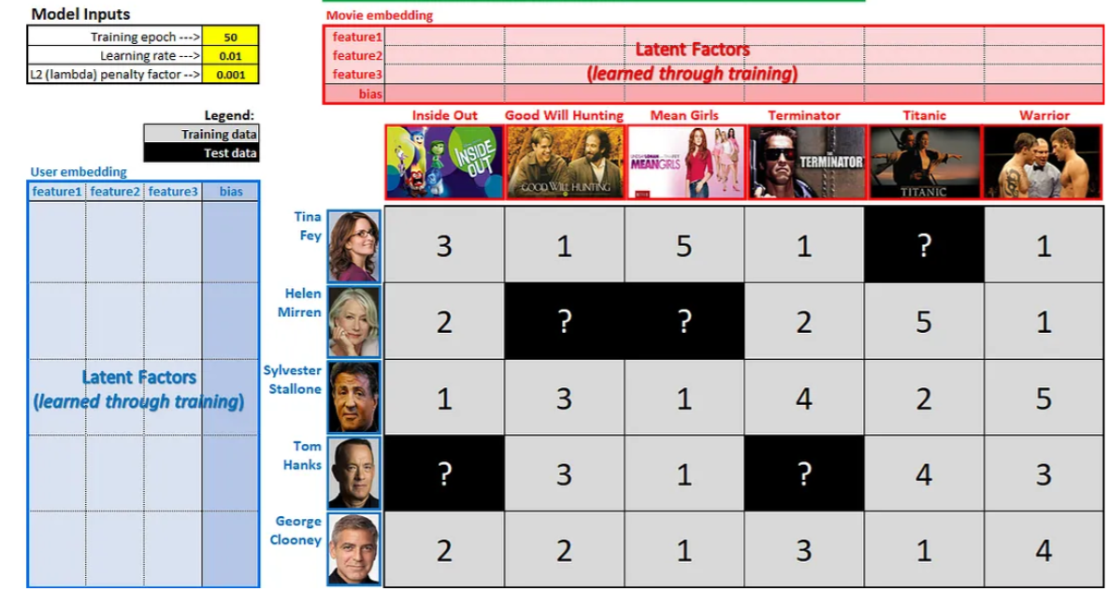
Data Preparation
Explore
Cleaning
Visualising
Selecting the algorithm
Creating our training and testing set
Notes:
Feature Engineering ( Hot encoder for category)

Slide 22

Modeling
Notes:
IV. Modeling
1. Select Modeling Techniques
Algorithm Selection: For a recommendation system, common techniques include collaborative filtering, content-based filtering, and hybrid methods. Machine learning models like neural networks (for deep learning approaches) and matrix factorization techniques can also be effective.
2. Generate Test Design
Data Splitting: Divide the data into training, validation, and test sets to evaluate the model's performance. A common approach is to use a time-based split for recommendation systems to mimic how users would interact with the system over time.
3. Build Model
Model Training: Implement the chosen algorithms. For example, training a collaborative filtering model might involve executing code that calculates similarity scores between users or items. A deep learning approach could require setting up a neural network architecture and training the model on user interaction data.
4. Assess Model
Evaluation: Use metrics such as precision, recall, RMSE (Root Mean Square Error), or AUC (Area Under the Curve) to compare the performance of different models. The choice of metrics should reflect the business objectives, such as increasing user engagement or satisfaction.
Interpretation: Assess the models based on their ability to recommend movies that align with user preferences. This involves a combination of quantitative metrics and qualitative assessments (e.g., user feedback on recommendations).
The Data Preparation and Modeling phases are iterative. Insights from model assessments may lead back to data preparation for further refinement. By meticulously preparing the data and thoughtfully selecting and evaluating models, a movie recommendation system can be optimized to deliver personalized and engaging user experiences.

Slide 23
Modeling
1. Select Modeling Techniques
Algorithm Selection: For a recommendation system, common techniques include collaborative filtering and content-based filtering.
2. Generate Test Design
Data Splitting: Divide the data into training, validation, and test sets to evaluate the model's performance.
Notes:
IV. Modeling
1. Select Modeling Techniques
Algorithm Selection: For a recommendation system, common techniques include collaborative filtering and content-based filtering. Machine learning models like neural networks (for deep learning approaches) and matrix factorization techniques can also be effective.
2. Generate Test Design
Data Splitting: Divide the data into training, validation, and test sets to evaluate the model's performance. A common approach is to use a time-based split for recommendation systems to mimic how users would interact with the system over time.
3. Build Model
Model Training: Implement the chosen algorithms. For example, training a collaborative filtering model might involve executing code that calculates similarity scores between users or items. A deep learning approach could require setting up a neural network architecture and training the model on user interaction data.
4. Assess Model
Evaluation: Use metrics such as precision, recall, RMSE (Root Mean Square Error), or AUC (Area Under the Curve) to compare the performance of different models. The choice of metrics should reflect the business objectives, such as increasing user engagement or satisfaction.
Interpretation: Assess the models based on their ability to recommend movies that align with user preferences. This involves a combination of quantitative metrics and qualitative assessments (e.g., user feedback on recommendations).
The Data Preparation and Modeling phases are iterative. Insights from model assessments may lead back to data preparation for further refinement. By meticulously preparing the data and thoughtfully selecting and evaluating models, a movie recommendation system can be optimized to deliver personalized and engaging user experiences.

Slide 24
Modeling
3. Build Model
Model Training: Implement the chosen algorithms.
Notes:
IV. Modeling
1. Select Modeling Techniques
Algorithm Selection: For a recommendation system, common techniques include collaborative filtering and content-based filtering. Machine learning models like neural networks (for deep learning approaches) and matrix factorization techniques can also be effective.
2. Generate Test Design
Data Splitting: Divide the data into training, validation, and test sets to evaluate the model's performance. A common approach is to use a time-based split for recommendation systems to mimic how users would interact with the system over time.
3. Build Model
Model Training: Implement the chosen algorithms. For example, training a collaborative filtering model might involve executing code that calculates similarity scores between users or items. A deep learning approach could require setting up a neural network architecture and training the model on user interaction data.
4. Assess Model
Evaluation: Use metrics such as precision, recall, RMSE (Root Mean Square Error), or AUC (Area Under the Curve) to compare the performance of different models. The choice of metrics should reflect the business objectives, such as increasing user engagement or satisfaction.
Interpretation: Assess the models based on their ability to recommend movies that align with user preferences. This involves a combination of quantitative metrics and qualitative assessments (e.g., user feedback on recommendations).
The Data Preparation and Modeling phases are iterative. Insights from model assessments may lead back to data preparation for further refinement. By meticulously preparing the data and thoughtfully selecting and evaluating models, a movie recommendation system can be optimized to deliver personalized and engaging user experiences.

Slide 25
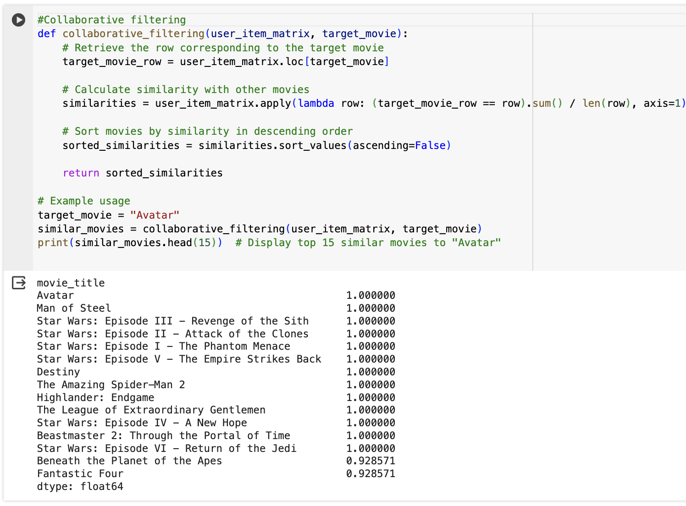
Collaborative Filtering
Relies on User Behavior: It identifies similarities between users or items and suggests items liked by similar users.
No Need for Item Features: not require information about the items being recommended, base on user-item interactions to generate recommendations.
Addresses Cold-Start Problem: struggle with new users or items due to the cold-start problem, sufficient interaction data might hard to provide accurate data.

Slide 26
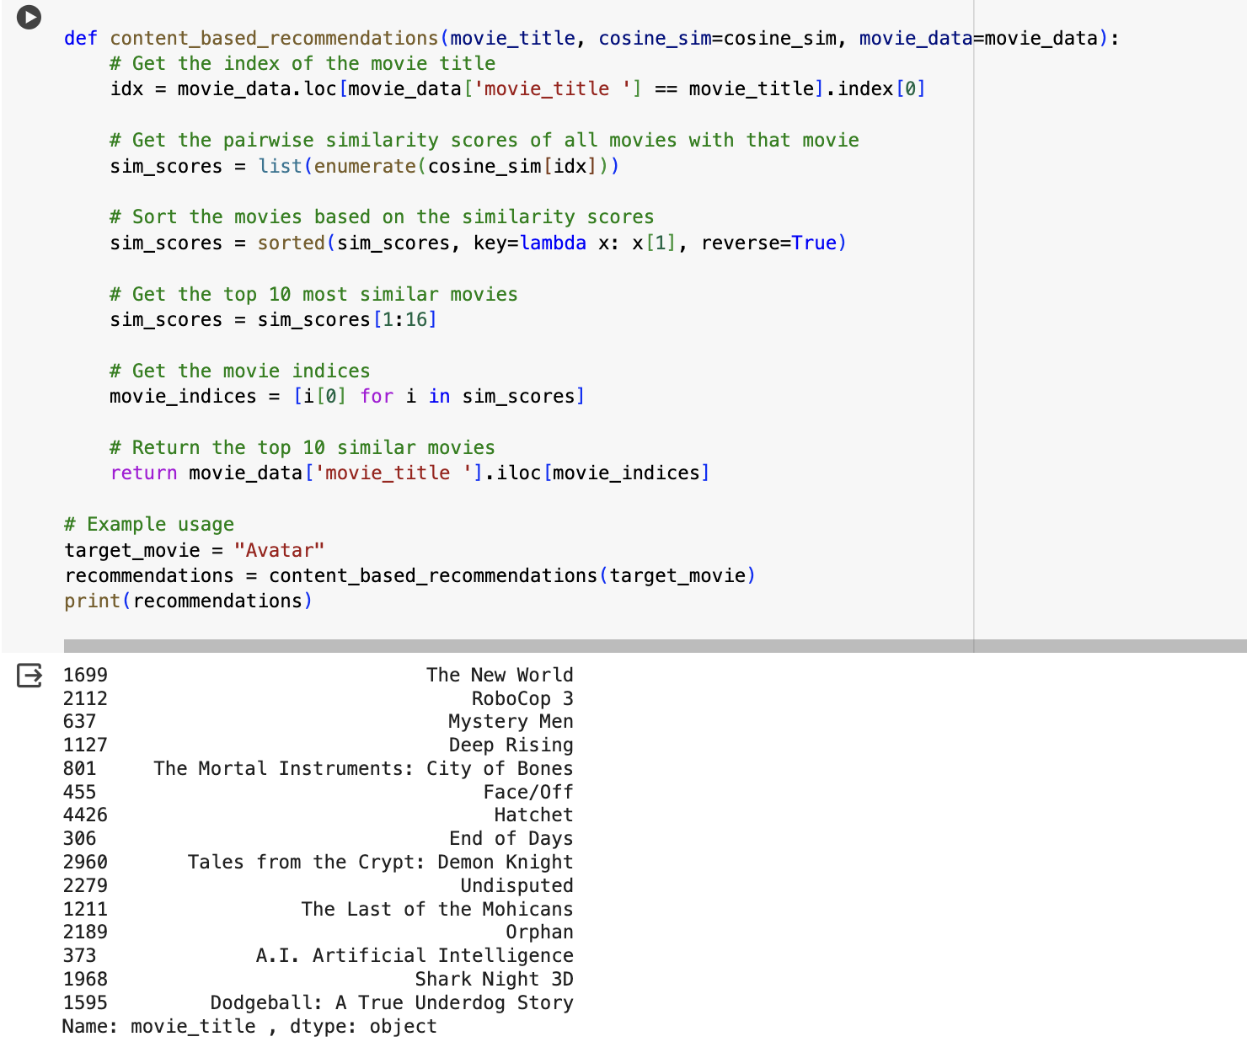
Content Based Filtering
Uses Item Features: It analyzes attributes of items, such as genre, keywords, or metadata, to match them with user preferences.
Less Dependent on User Behavior: relies less on past user behavior and more on the intrinsic properties of items.
Addresses Cold-Start Problem: It can recommend new items by leveraging their features, even if there is limited interaction data.
Link: https://colab.research.google.com/drive/11AnXhWMXp-e8dyFbl-3_ez-zas_v1140#scrollTo=GUnvSv7lVOiD

Slide 27
Criteria | Collaborative Filtering | Content Based Filtering
Methodology | Relies on past user-item interactions to generate recommendations. | Utilizes additional information about users and/or items (e.g., item features, user profiles).
Approach | Identifies similar users or items based on their interactions and suggests items liked by similar users. | Recommends items similar to those the user has interacted with, based on their features or characteristics.
Algorithm | Typically uses Nearest Neighbor algorithms to find similar users or items. | Builds a model based on available features to explain user-item interactions and make predictions.
Advantages | It identifies patterns in user behavior and preferences to recommend items that similar users have liked. In the context of a subscription service, Collaborative Filtering can be effective in recommending movies or content based on the viewing history and preferences of similar users. It can help address viewership decline by suggesting relevant content that other users with similar tastes have enjoyed, potentially increasing engagement and retention. | It analyzes the characteristics of the content (e.g., genre, actors, plot keywords) and matches them with user preferences to make recommendations. In the context of a subscription service, Content-Based Filtering can be effective in recommending movies or content that are similar to what a user has previously enjoyed. It can help address viewership decline by suggesting relevant content based on the specific preferences of users, potentially increasing engagement and retention.
Notes:
Content-Based Filtering: Content-Based Filtering complements Collaborative Filtering by recommending movies based on their features or characteristics. This method allows you to promote the latest movie updates by matching them with subscribers' interests and preferences. By analyzing attributes like genre, cast, or plot keywords, Content-Based Filtering can recommend movies that are likely to appeal to specific subscriber segments. This approach is beneficial for showcasing new releases and tailored recommendations based on the unique qualities of each movie.
A hybrid model for a movie recommendation system is preferred as it blends the personalized recommendations of collaborative filtering with the detailed content analysis of content-based filtering. This combination provides more accurate, diverse, and adaptable suggestions while mitigating issues like the cold start problem and echo chambers, leading to a superior user experience.

Slide 28

Evaluation
Notes:
Evaluate Results
Business Success Criteria Alignment: Assess how well the models meet predefined business goals, such as improving user engagement, increasing watch time, and boosting subscription rates. Metrics might include an increase in user interaction with recommended movies, higher satisfaction ratings, or positive feedback on the recommendation quality.
Model Selection: Choose the model that best meets these criteria. This decision should be based on a combination of quantitative performance metrics (e.g., precision, recall) and qualitative assessments, such as user feedback on the relevance and diversity of recommendations. It's crucial to consider the balance between accuracy and computational efficiency, especially for systems that require real-time recommendations.
Review Process
Process Evaluation: Conduct a thorough review of the data mining process to identify any areas for improvement. This includes evaluating the completeness and quality of the data used, the effectiveness of data preparation techniques, and the appropriateness of the modeling approaches.
Findings Summary: Document the key findings from this review. If any steps were overlooked or if there were areas where the execution could be improved, detail these points and suggest how they could be addressed in future iterations. For example, if integrating additional data sources could potentially improve recommendation quality, note this for future development.
Corrective Actions: Based on the review, outline any immediate actions needed to rectify oversights or errors in the earlier phases. This might involve revisiting the Data Preparation phase to clean additional datasets or refining the model selection based on new insights.
Determine Next Steps
Deployment Decision: Decide whether the current model is ready for deployment based on its alignment with business goals and the outcomes of the process review. If the model is deemed ready, plan for the integration of the recommendation system into the live environment, ensuring scalability and performance monitoring mechanisms are in place.
Further Iteration: If the model does not fully meet the business objectives or if there is room for significant improvement, identify specific areas for iteration. This could involve exploring additional modeling techniques, incorporating new data sources, or refining the evaluation metrics.
New Projects Initiation: In some cases, the evaluation might reveal new opportunities or challenges that warrant the initiation of new projects. For example, the need for better user profiling might lead to a project focused on enhancing user data collection and analysis.
The Evaluation phase is essential for ensuring that the movie recommendation system will deliver value to the business and its users. By systematically evaluating the results, reviewing the process, and determining the next steps, you can ensure that the final system is well-positioned to meet the desired objectives and is capable of evolving in response to new challenges and opportunities.

Slide 29
Evaluate Results
Business Success Criteria Alignment: Record user interaction with planned algorithm
Model Selection: Chosen the hybrid model since it best meet our business objectives
Notes:
Evaluate Results
Business Success Criteria Alignment: Record user interaction with planned algorithm to track user engagement, user watch time and boosting subscription
We’ve chosen this model since it best meet our business objectives. -> This allow us to
To counter the viewership decline and boost engagement, we're implementing a hybrid recommendation system. This approach combines collaborative and content-based models to offer personalized, varied recommendations, addressing new user challenges and preventing content stagnation, ultimately aiming to increase viewing time and engagement.

Slide 30
Review Process
Process Evaluation: Conduct a thorough review of the data mining process to identify any areas for improvement.
Findings Summary: Document the key findings from this review.
Corrective Actions: Based on the review, outline any immediate actions needed to rectify oversights or errors in the earlier phases.
Notes:
Review Process
Process Evaluation: Conduct a thorough review of the data mining process to identify any areas for improvement. This includes evaluating the completeness and quality of the data used, the effectiveness of data preparation techniques, and the appropriateness of the modeling approaches.
Findings Summary: Document the key findings from this review. If any steps were overlooked or if there were areas where the execution could be improved, detail these points and suggest how they could be addressed in future iterations. For example, if integrating additional data sources could potentially improve recommendation quality, note this for future development.
Corrective Actions: Based on the review, outline any immediate actions needed to rectify oversights or errors in the earlier phases. This might involve revisiting the Data Preparation phase to clean additional datasets or refining the model selection based on new insights.

Slide 31

Testing / Validation
Testing:
Try out the system with selected testers and scenarios.
Gather feedback on the recommendations received.
Evaluate the system's performance based on user feedback.
Validation:
Confirm the relevance and helpfulness of recommendations.
Compare recommendations to users' actual preferences.
Determine if the system accurately predicts users' movie choices.
Notes:
During the testing phase, we put our recommender system through its paces with a select group of users across various scenarios. Feedback was collected to gauge the system's performance, focusing on user satisfaction with the recommendations provided.
Transitioning to validation, we closely examined whether the recommendations matched users' actual preferences and interests. This meant confirming that our system wasn't just accurate technically, but also useful and enjoyable from a user's standpoint. We compared the recommended movies to what users ultimately chose to watch, giving us a clear picture of the system's predictive capabilities.

Slide 32
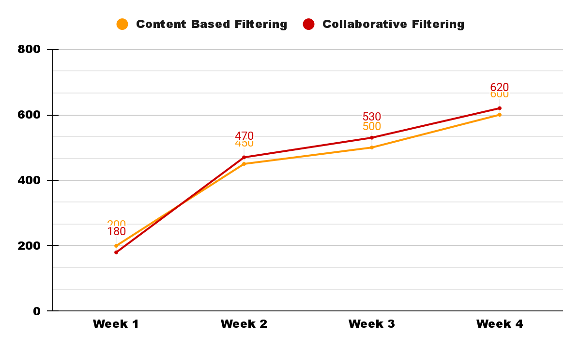

User Feedback Satisfaction (Likes)
Notes:
For evaluation, we will use user feedbacks to benchmark the algorithm effectiveness
The chart shows improvement in both content-based and collaborative filtering, yet neither is consistently superior. A hybrid model could stabilize satisfaction levels and ensure steady improvement by merging the personalization of collaborative filtering with the diverse content discovery of content-based filtering, thereby increasing the system’s overall effectiveness.

Slide 33
Determine Next Steps
Deployment Decision: Decide whether the current model is ready for deployment based on its alignment with business goals and the outcomes of the process review.
Further Iteration: If the model does not fully meet the business objectives or if there is room for significant improvement, identify specific areas for iteration.
Prototyping: With our objectives in mind, we will need to create a Minimum viable product to plan our implementation.
Notes:
Determine Next Steps
Deployment Decision: Decide whether the current model is ready for deployment based on its alignment with business goals and the outcomes of the process review. If the model is deemed ready, plan for the integration of the recommendation system into the live environment, ensuring scalability and performance monitoring mechanisms are in place.
Further Iteration: If the model does not fully meet the business objectives or if there is room for significant improvement, identify specific areas for iteration. This could involve exploring additional modeling techniques, incorporating new data sources, or refining the evaluation metrics.
New Projects Initiation: In some cases, the evaluation might reveal new opportunities or challenges that warrant the initiation of new projects. For example, the need for better user profiling might lead to a project focused on enhancing user data collection and analysis.
Now i will pass to renato, to tell you more about about Minimum Viable Product

Slide 34

Minimum Viable Product

Slide 35

MVP (Minimum Viable Product)
Focus on essential features
Quickly produce a working platform
Iterations: Improvement based on user feedbacks
WIREFRAMING, USER TESTINGS, USER-CENTRIC DESIGN,
Notes:
We introduced a Minimum Viable Product as our prototyping plan.
This allows us to focus on essential features and quickly produce a working platform to gather user feedbacks
From the feedbacks collected we can then iterate and improve our product.

Slide 36
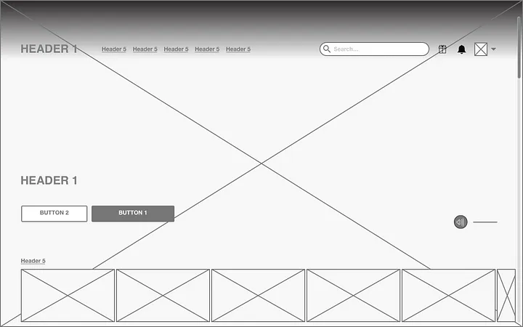
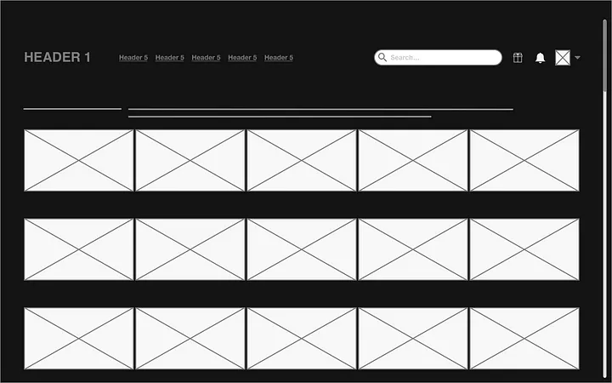


Wireframe for our main Platform
Screen 1: Homepage
Screen 2: Search
Search Algorithm
Recommendation Algorithm
Screen 4: Player
Screen 3: Title

Slide 37
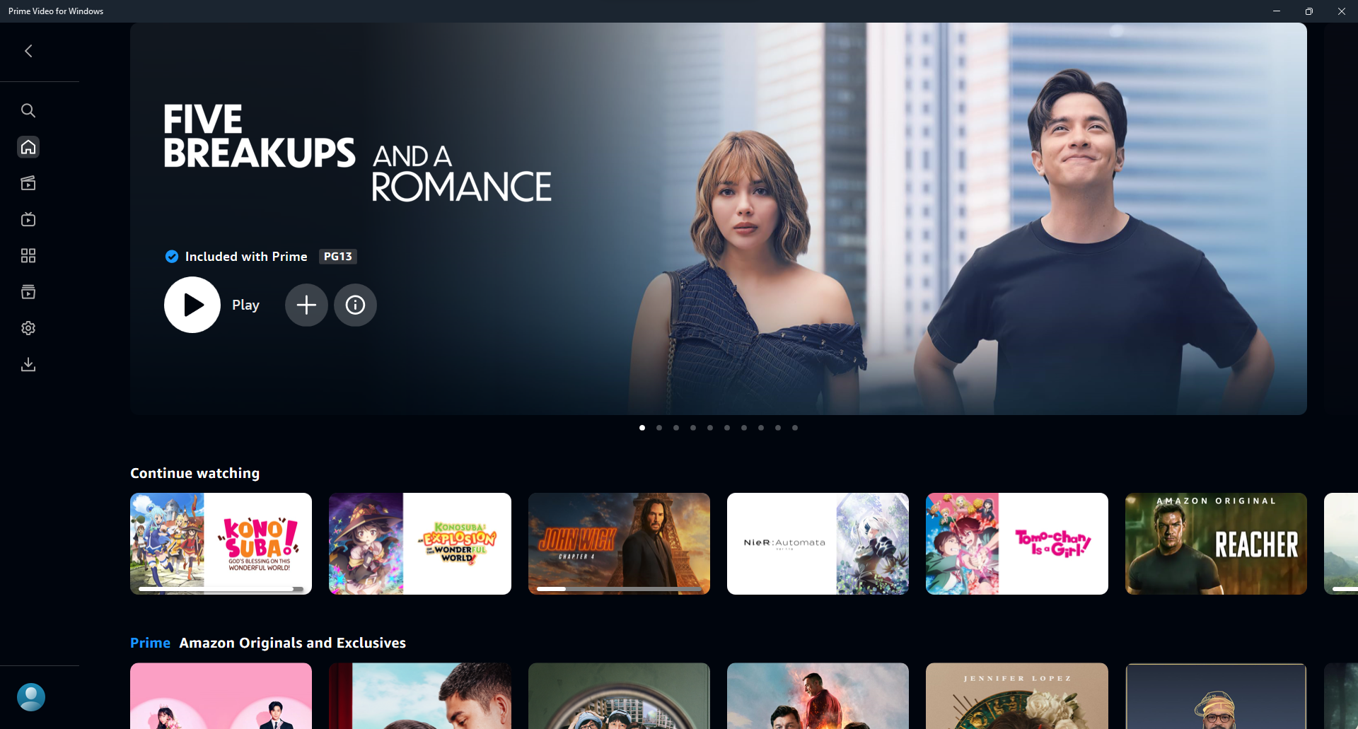
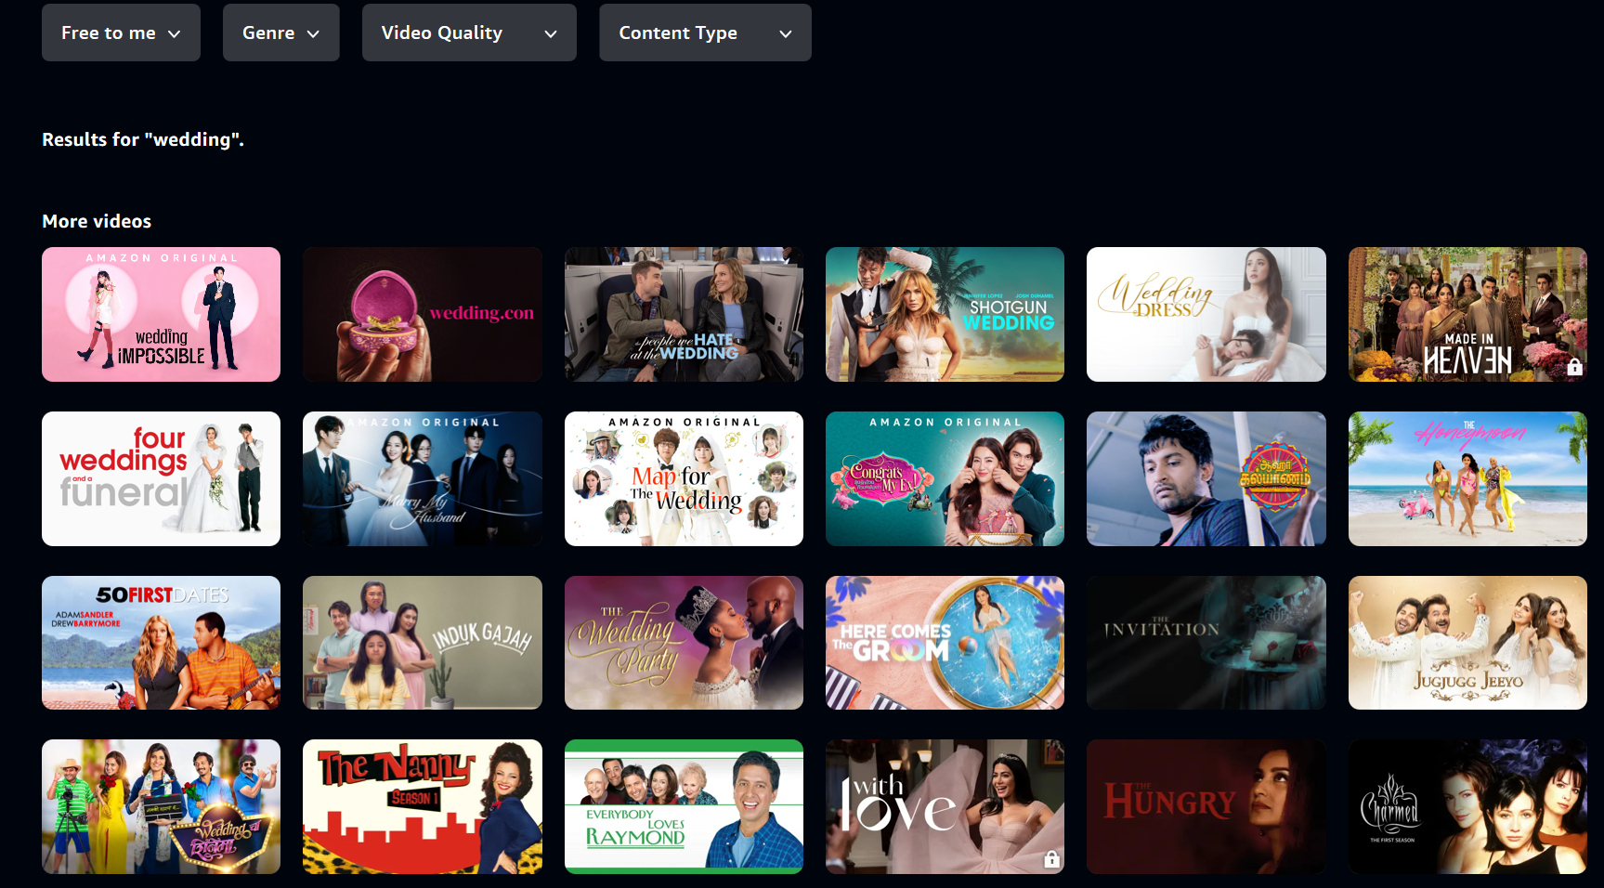
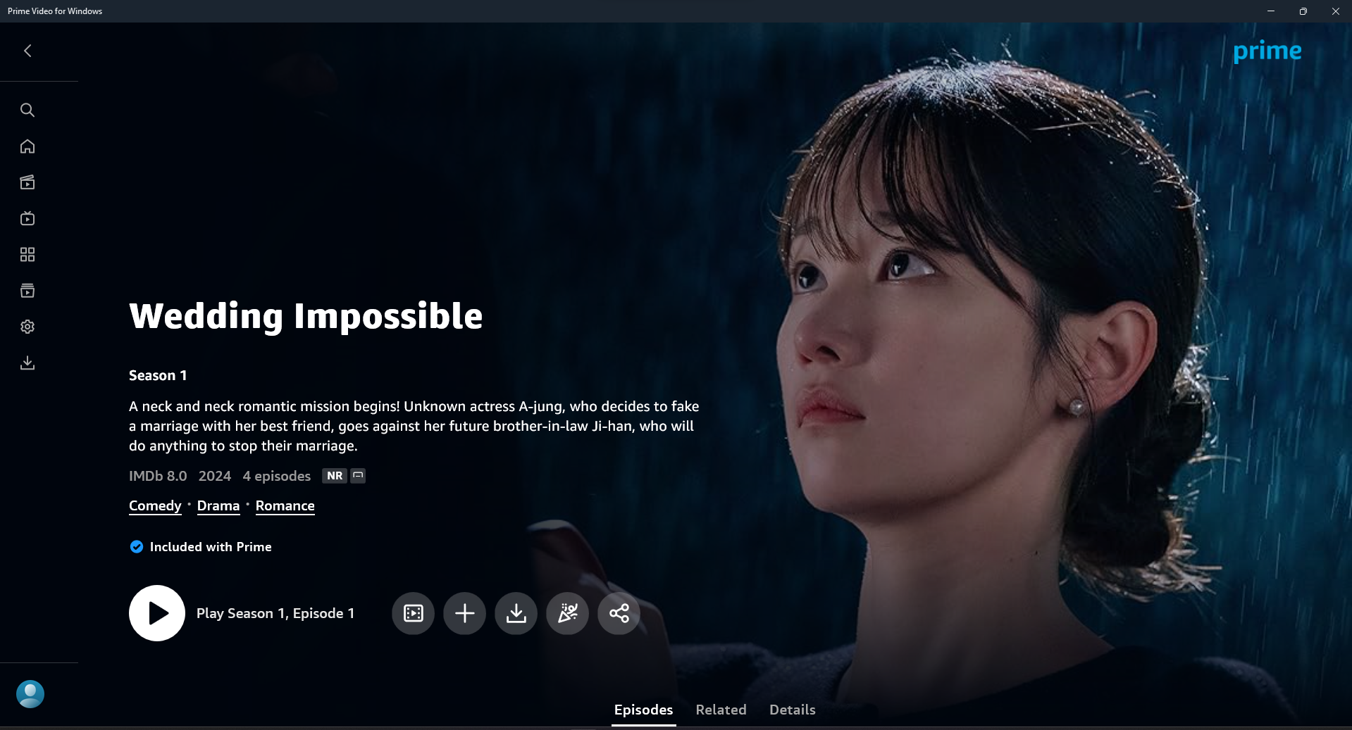
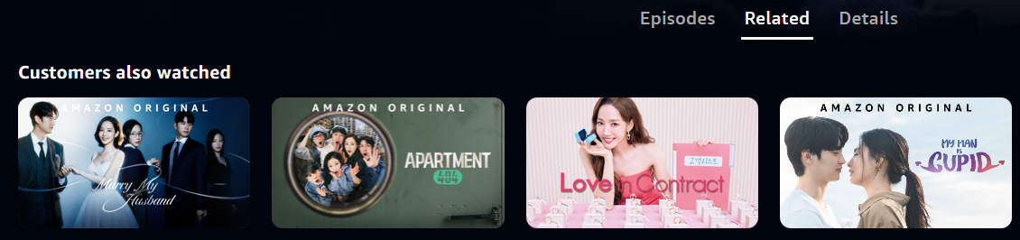
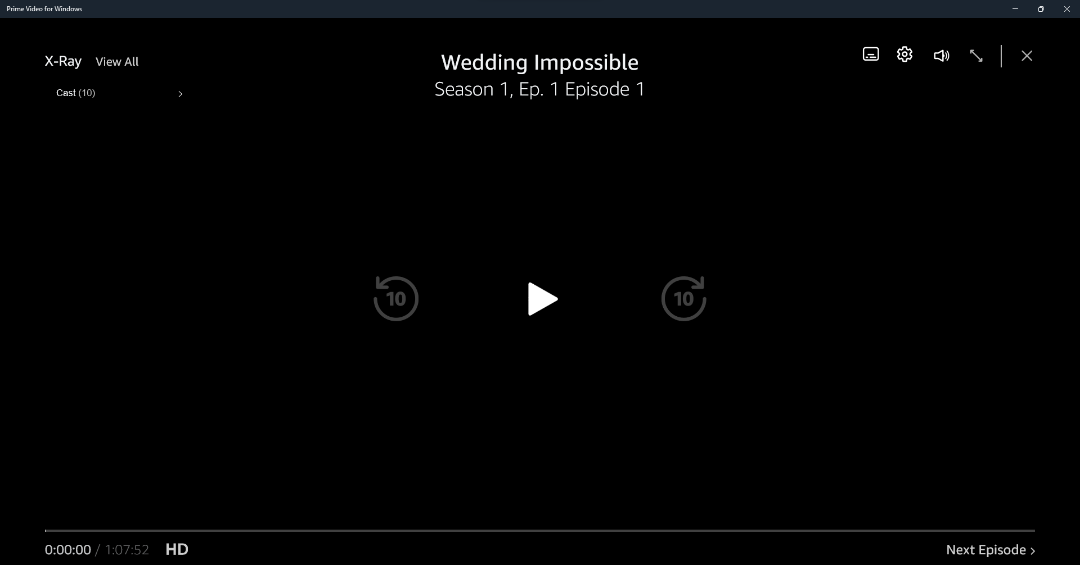
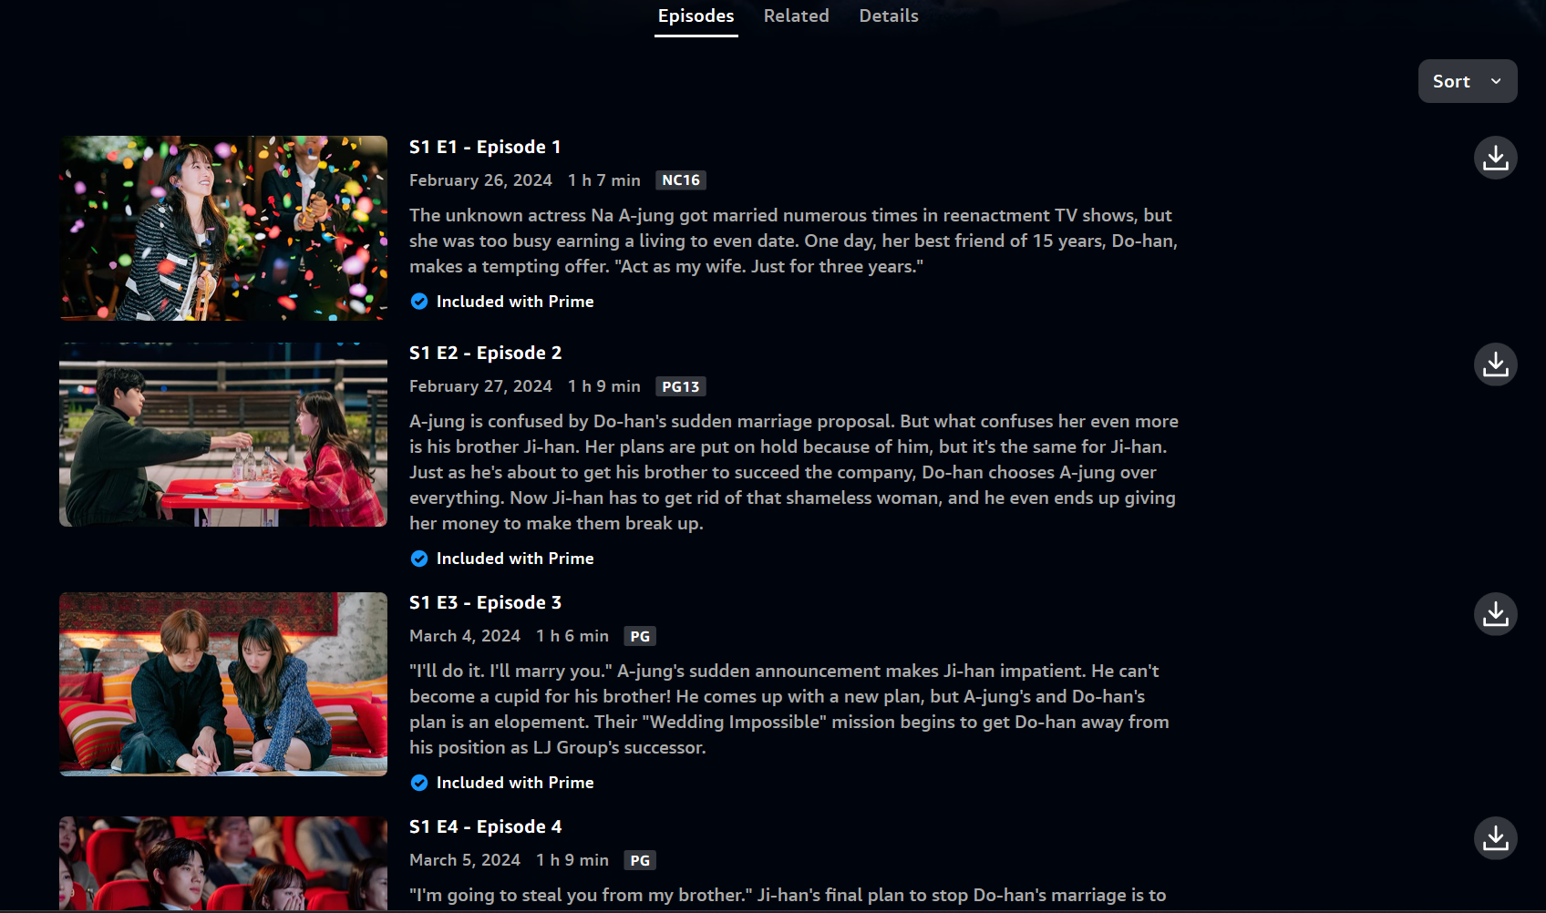
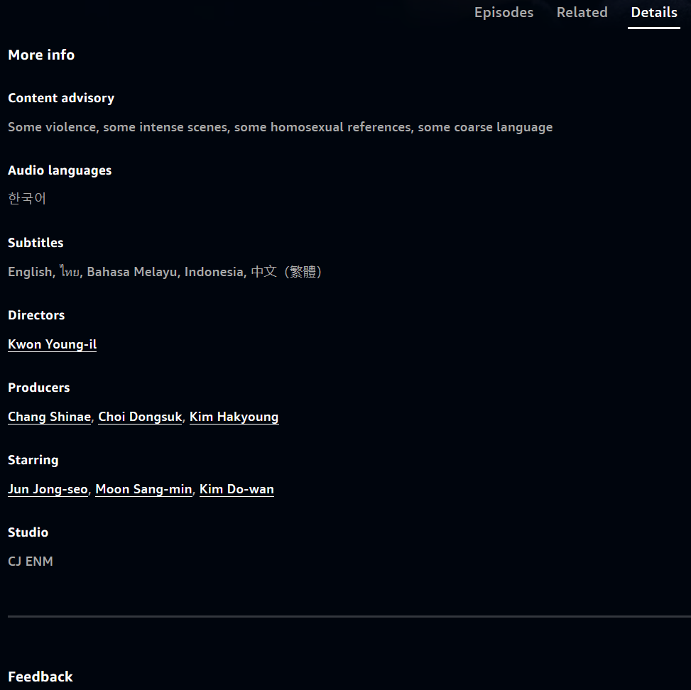
Screen 1: Homepage
Screen 2: Search
Screen 3: Title
Screen 4: Player

Slide 38
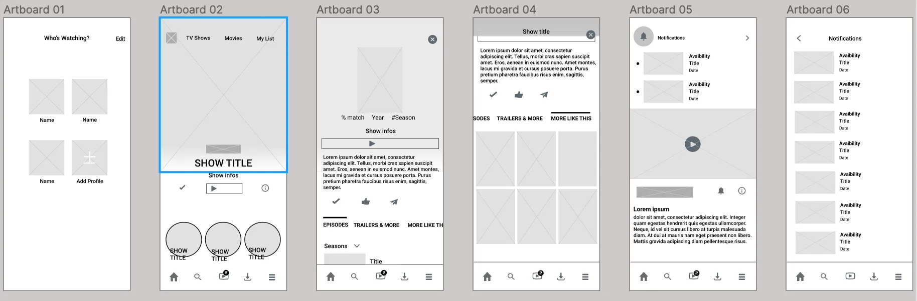
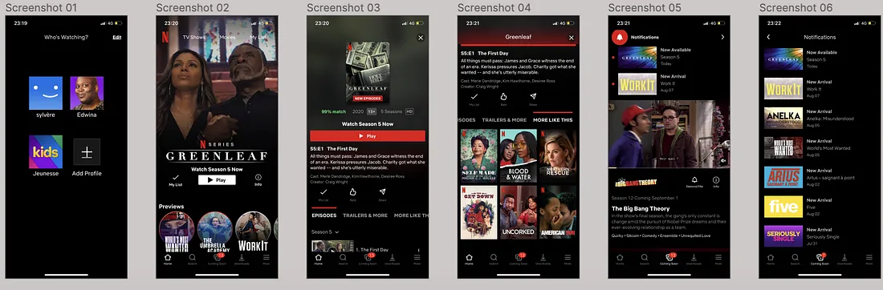
Future Enhancement: Android/IOS Prototype

Slide 39

Deployment
Notes:
For a movie recommendation system, the Deployment phase is pivotal for bringing the model into a live environment where it can start delivering value to users by suggesting movies they're likely to enjoy. This phase ensures the seamless integration of the model into existing systems, along with setting up mechanisms for ongoing monitoring and maintenance. Here's how the tasks in this phase can be approached:
Plan Deployment
Deployment Strategy: Develop a detailed plan for integrating the recommendation system into the user platform. This might involve updating the platform's backend to include the recommendation algorithm, ensuring the frontend can display recommendations effectively, and integrating with user profiles to personalize suggestions.
Technical Requirements: Document the technical infrastructure needed to support the deployment, such as server capacity, data storage requirements, and any necessary software updates or installations.
Timeline and Milestones: Establish a timeline for deployment, including key milestones and deadlines to ensure the process stays on track.
Plan Monitoring and Maintenance
Monitoring Plan: Set up systems to continuously monitor the recommendation system's performance, looking for issues such as declining accuracy, slow response times, or user feedback indicating dissatisfaction with recommendations.
Maintenance Schedule: Develop a schedule for regular maintenance tasks, such as updating the model with new data, retraining to adjust for changes in user behavior or movie trends, and performing system checks to ensure technical infrastructure is functioning properly.
Issue Response Plan: Outline procedures for addressing technical problems or sudden drops in recommendation quality, including escalation paths and communication plans for informing stakeholders of issues.
Produce Final Report
Project Summary: Document a comprehensive summary of the project, including objectives, methodologies used, key findings, and the outcome of the deployment phase. This report serves as a record of the project and its achievements.
Results Presentation: Include a detailed presentation of the data mining results, showing how the recommendation system meets the business objectives outlined in the initial phases. Highlight metrics demonstrating the system's impact on user engagement and satisfaction.
Lessons Learned: Share insights gained during the project, including challenges faced and how they were overcome. This section can provide valuable learnings for future projects.
Review Project
Project Retrospective: Conduct a review of the entire project, involving team members from each phase to discuss what went well and what could have been improved. This can cover aspects such as project management, team collaboration, technical challenges, and adherence to timelines.
Improvement Plan: Based on the retrospective, develop a plan for improving future projects. This might include recommendations for better data management practices, more efficient model development techniques, or enhanced collaboration and communication among team members.
Knowledge Sharing: Consider ways to share the learnings and successes from this project with other teams or departments within the organization, possibly through internal presentations or workshops. This can help spread best practices and encourage the adoption of data-driven decision-making across the enterprise.
The Deployment phase is not the end of the project but the beginning of the recommendation system's life in a production environment. Effective planning, monitoring, and maintenance ensure that the system remains relevant and continues to provide value to users over time.

Slide 40
When is Deployment done
After taking into consideration the effect it has on key stakeholder
After thorough evaluation/testing of the model is done
After Setting up the infrastructure needed to integrate the solution into the system

Slide 41
Our Deployment Objectives
To enhance recommendation system by considering user’s overall behaviour and preferences.
Allow us to log user data and improve model using the data
Allow us a real time analytics and monitoring of the system statistics

Slide 42
Deployment strategies
Integration Strategy :
Integrations will be through the Middleware integration
Deployment Strategy :
Deployment technique that we will use : blue - green deployment technique
Deployment and monitoring tools that we could be using is either New Relic or Prometheus
Scalability Strategy :
Prepare for an increase in processing used to determine the movie to recommend eg. load balancing, caching mechanism
Notes:
Integration thru middleware because the other methods are not as good as this one
Blue - green deployment is to reduce down time of the app and to decrease the risk of issues regarding updates popping up
New relic is used to observe the application and allow for real time analytics
Prometheus is used as it allow us to store data and allow analytics as well
Load balancing is to balance the request and traffics to multiple server as there are going to be alot of requests for recommendation when it is going to get scaled up
Caching is to reduce the amount of same request that will be done by the system and then keeping cache of it to reduce the load be done on the server
https://medium.com/@yennhi95zz/6-the-deployment-phase-of-the-crisp-dm-methodology-a-detailed-discussion-f802a7cb9a0f#:~:text=The%20Deployment%20phase%20of%20the%20CRISP%2DDM%20methodology%20refers%20to,used%20to%20drive%20business%20value.

Slide 43
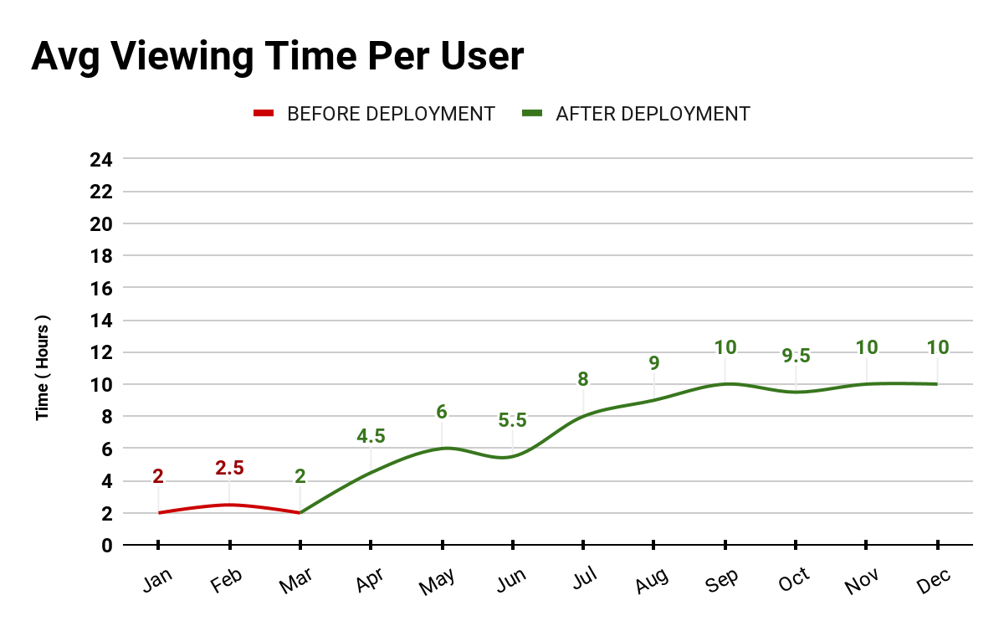
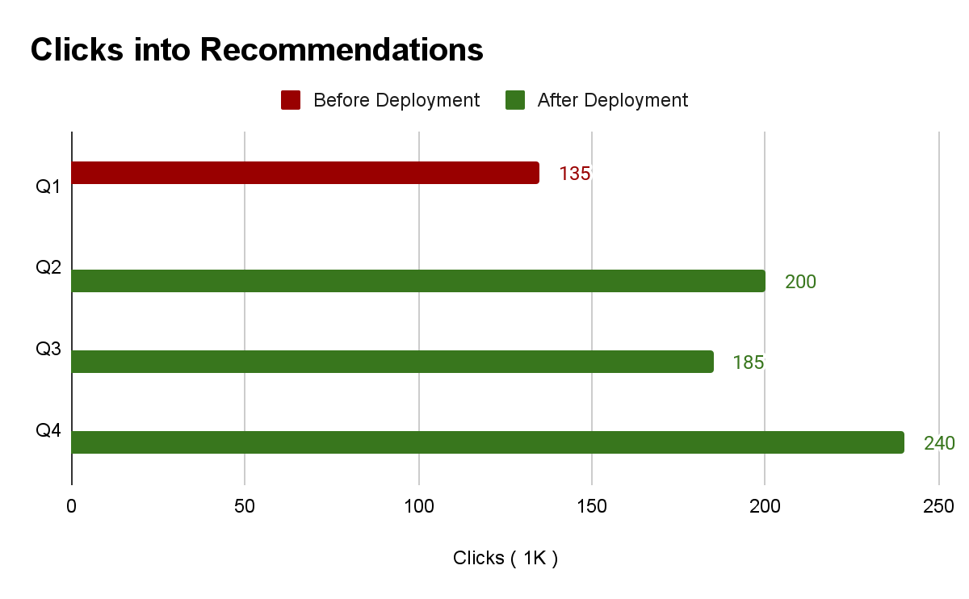
Deployment (Tangible Results)
Avg viewing time per user
Logged from before the use of the algorithm to after the use of it to let us see the effectiveness
Clicks into recommended movies
Logging the click on recommended movies to see the engagement produced by the algorithm

Slide 44
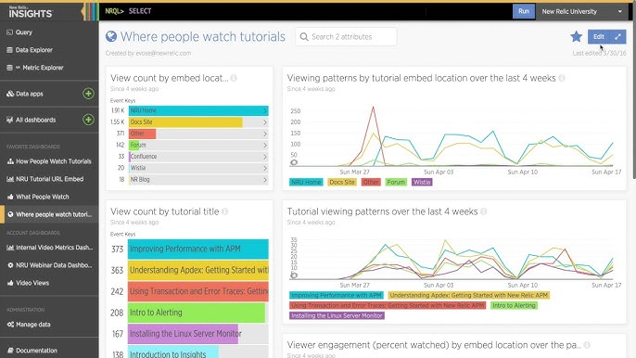
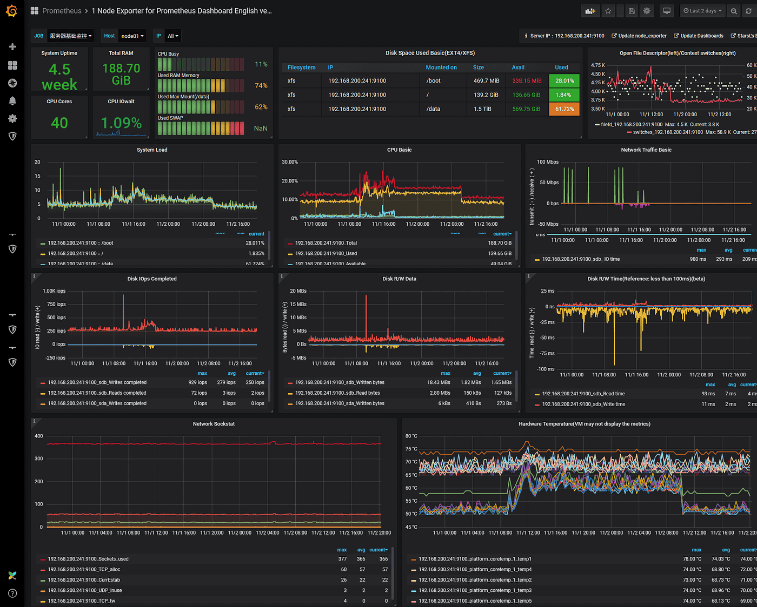
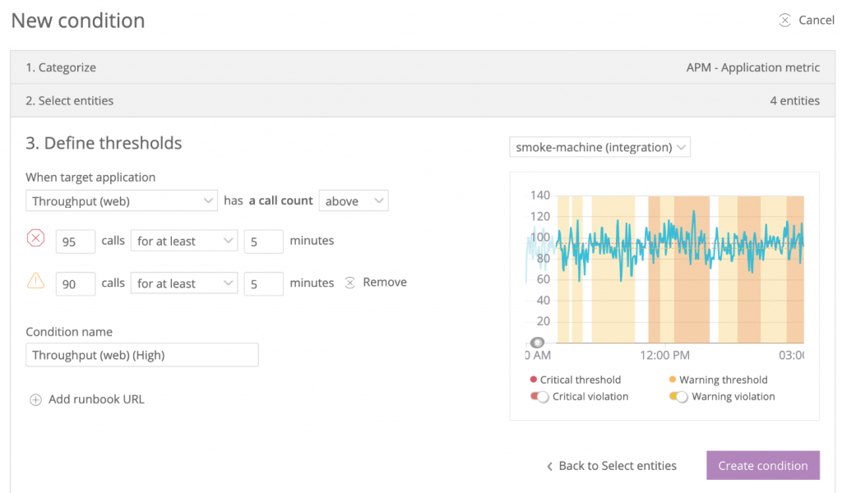
Monitoring & Analytics
PROMETHEUS
NEW RELIC
Dashboard to give user and application data allowing analysis.
Allows monitoring of user and app data
Allows for alerting of the app

Slide 45

Conclusion

Slide 46
Conclusion
Business Goals & Objectives
User-centric algorithms
Strategic Intervention
CRISP-DM helps guide us in creating the process for understanding the user’s preference by understanding the trends of the current consumer’s behaviour and helps us make well informed decision to proceed with searching for more of the related movies to be listed.
Notes:
As per Crisp-dm, this project outlines how we use business planning and understanding
Business Planning is integral to our project as it gathers input and feedback from our key stakeholders
Personalized recommendations based on user behavior and movie features significantly enhance user engagement.
The use of advanced algorithms and data analysis resulted in a user-centric recommendation process.
Strategic intervention, utilizing prescriptive analytics, effectively addressed the decline in viewership, revitalizing audience engagement.

Slide 47
THE END
— GROUP 3 —

Slide 48
References
https://medium.com/@yennhi95zz/6-the-deployment-phase-of-the-crisp-dm-methodology-a-detailed-discussion-f802a7cb9a0f#:~:text=The%20Deployment%20phase%20of%20the%20CRISP%2DDM%20methodology%20refers%20to,used%20to%20drive%20business%20value.
https://www.datascience-pm.com/crisp-dm-2/
https://www.sv-europe.com/crisp-dm-methodology/
https://medium.com/the-modern-scientist/the-crisp-dm-framework-a-comprehensive-guide-for-data-mining-success-3b52a3edb3d0
https://medium.com/marketingdatascience/kdd-semma-crisp-dm%E4%B9%8B%E6%AF%94%E8%BC%83-3d9166bceaf4

